Slide 1

Basic course3-Composer
Yahboom
Yahboom OMIBOX Tutorial

Slide 2
1
2
3
4
5
Learning
goals
Search for
blocks
Combine
blocks
Experimental
phenomena
Preparation
程序编程
Tencent
Yahboom OMIBOX Tutorial

Slide 3
1
Preparation-1
1. The position of the buzzer in the robot car
2. Learn how to use buzzer graphically program building blocks
3. Learn how to control buzzer play different tone form a song by graphical programming
Yahboom OMIBOX Tutorial

Slide 4
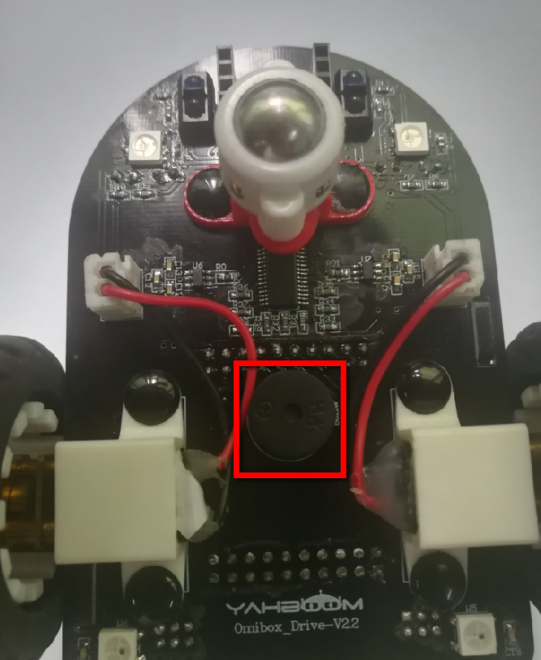
1
Preparation-1
As shown in the figure above, we circled the red wire frame with a buzzer, and we can make it play music by programming.
Yahboom OMIBOX Tutorial

Slide 5
2
Learning goals
In this lesson, we will learn how to use the buzzer on the Omibox and play song-《ducks》.
Yahboom OMIBOX Tutorial

Slide 6
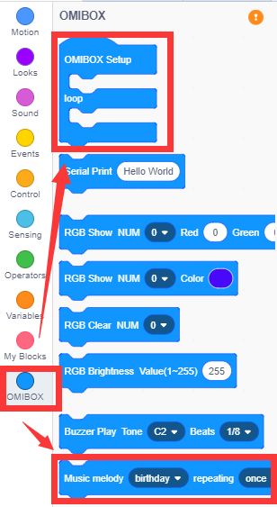
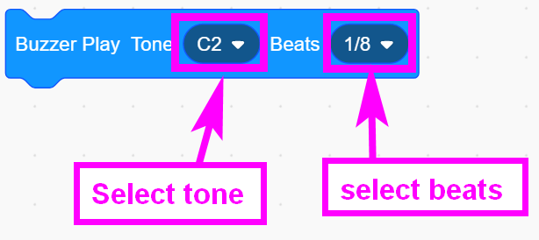
3
Search for blocks
The following is the location of the building blocks required for this programming.
Yahboom OMIBOX Tutorial

Slide 7
4
Combine blocks
Please refer to the Composer.sb3 file of this experiment.
Yahboom OMIBOX Tutorial

Slide 8
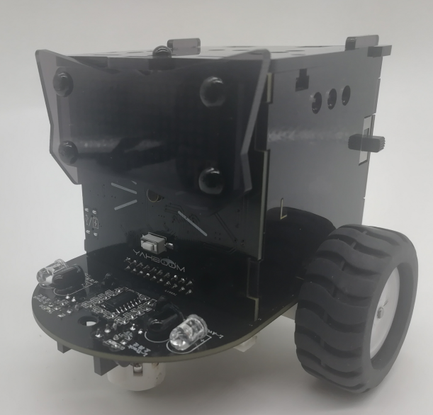
5
Experimental phenomena
After the program is uploaded, the car will be powered up normally, and we can hear the buzzer playing "Ducks".
Yahboom OMIBOX Tutorial

Slide 9
Inspire Creativity Embrace Innovation
Thank you!!!
Yahboom

